Slide 1
SCIENCE GATEWAY by TeamZenith
ANUJ BHANDAR
ATUL MOHAN
ARPIT AGARWAL

Slide 2
AGENDA
Overview
CI/Cd Design Decisions
Travis CI
Microservices
Future Work

Slide 3
CI/CD Design Decisions
Continuous Integration
Software development practice where members of a team integrate their work frequently.
Continuous delivery
Software engineering approach in which teams produce software in short cycles
Ensures that the software can be reliably released at any time.
Examples: Travis CI, Jenkins, Puppet, Buildbot

Slide 4
CI/CD Design Decisions
After a thorough research, we had to choose between Travis CI and Jenkins
Preferred Travis CI over Jenkins
Travis CI is one of the most popular CI tools – More documentation
Travis CI is easier to setup
Travis CI can be easily configured on GitHub with a simple addition of a configuration file
Even though Jenkins provides ample integrations, Travis CI is found suitable for small scale projects such as Milestone-4

Slide 5
CI/CD Implementation
GitHub was integrated with AWS CodeDeploy using WebHooks
For performing the proper DevOps process (CI -> CD), Travis and Amazon S3 was introduced
AWS FDS was used for data storage
Challenges in setting up SQL and EC2
Port was not accessible
Tomcat server packaged along with war file
Deployment process: GitHub-> Travis -> S3 -> AWS Code Deploy

Slide 6
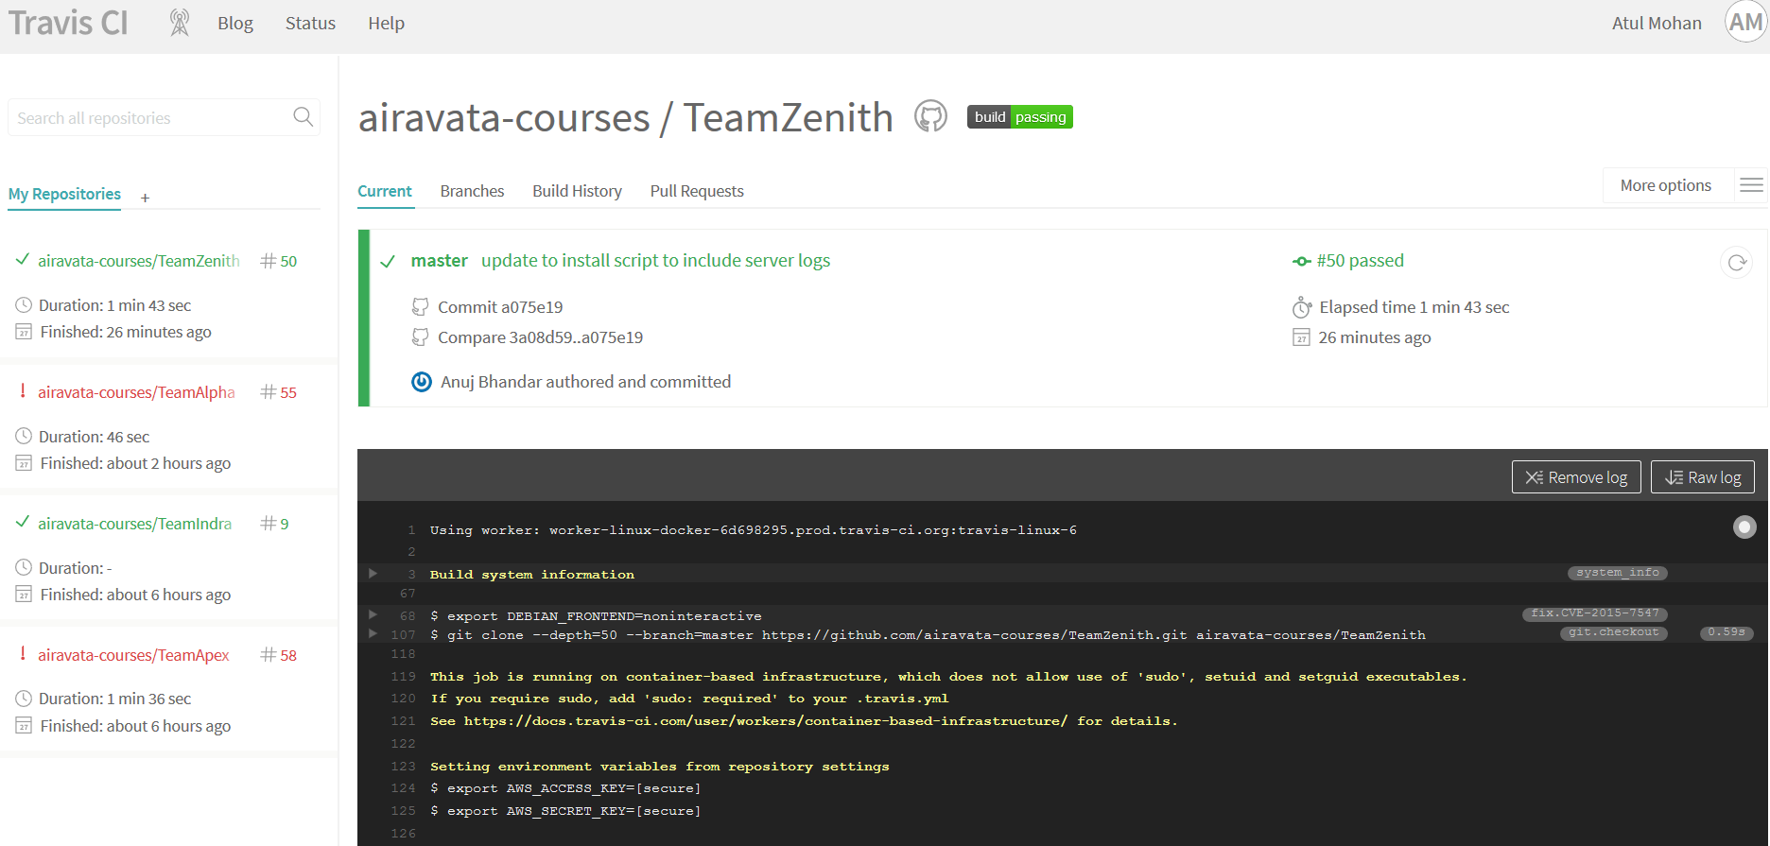
Travis CI Screenshot

Slide 7
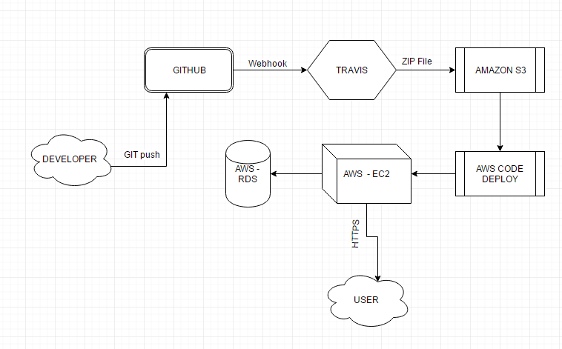
CI – CD Flowchart

Slide 8
Microservices
Microservices are small, independent processes
Communicate with each other to form complex applications
Utilize language-agnostic APIs
Decomposed monolithic TeamZenith gateway architecture to two separate Microservices
TeamZenithGatewayUI: UI components that are independently deployable
Supports User management along with Oauth2 token management
GatewayAPI: Service with endpoint for functionalities like Oauth token generation, job related services and database services

Slide 9
Microservices
Secured both the microservices using OAuth2 and API Key
Design pattern was followed with flexibility in mind:
API is separated from UI so that the service can be accessible for other services having a different UI as well

Slide 10
FUTURE WORK
Implement the CI/CD system for the microservice architecture
Implement fault tolerance and load balancing
Nginx
Tomcat 7 in built load balancer
Develop granular microservices such as services for ssh , Job submission and database services.

Slide 11
THANK YOU!!!

